Slide 1
MAAS-Hub Scalable homogenous architecture for multi agent systems
Moazzam Abdullah Khan
Daiem Nadir Ali
Nour Soufi
Segun Ajibola

Slide 2
Assumptions
Unlimited resources
All orders can be completed
No need to prioritize orders to maximize profit
Release time
Orders are released with individual specified delays
No deadlines
Orders don’t have a deadline attached
No need to prioritize orders to maximize profit
Fixed processing time
Each step has a specific completion delay
Location and distance doesn’t affect step completion time

Slide 3
Challenge
Customer places order
Orders require multiple steps to complete
Agents have to complete the order
Agents have specializations
Transporting
Can move
Painting
Can paint
Fastening
Can fasten two objects together
Deliver finished order to customer

Slide 4
Assumptions
Unlimited resources
All orders can be completed
No need to prioritize orders to maximize profit
Release time
Orders are released with individual specified delays
No deadlines
Orders don’t have a deadline attached
No need to prioritize orders to maximize profit
Fixed processing time
Each step has a specific completion delay
Location and distance doesn’t affect step completion time

Slide 5
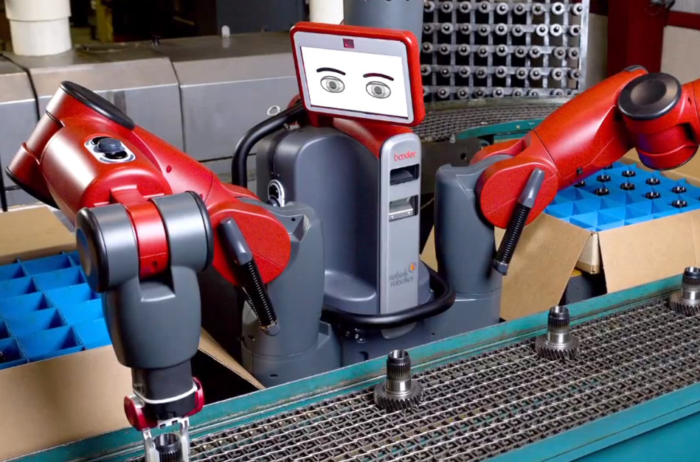
Our Motivations
Keep agents
Homogenous
Versatile
Indefinitely scalable
Baxter Robot: A versatile robot worker capable of doing complex tasks

Slide 6
Structure
Simple Agent
Queue Agent
Comms
Action Definitions
Role
Comms
Priority Queue

Slide 7
Communication Diagram
Order Generator
Acquisition Queue
Priority Queue
Simple
Worker
OutwardQueGUI
Delivery Queue

Slide 8
Structure
Simple Agent
Queue Agent
Comms
Action Definitions
Role
Comms
Priority Queue

Slide 9
Simple Worker
Role
Transporter
Painter
Fastener
Active Strategy
Passive Strategy

Slide 10

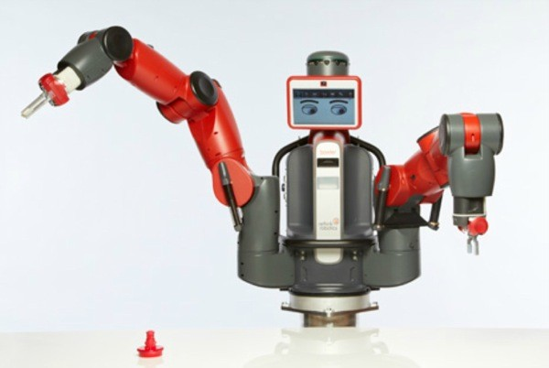

Command and Control
Every agent registers on yellow pages
Queue holds information on agent inventories
Objects have a number representing overall progress (step number) which is currently treated as priority
Nut:1
Red Nut:2
Nut:1
Red Nut:2
Queue
Fastener
Painter

Slide 11


Flow

Slide 12
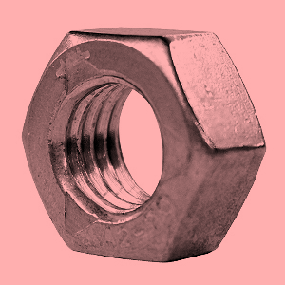
Flow

Slide 13
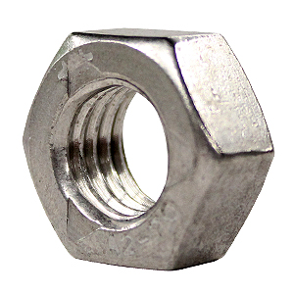

Flow

Slide 14


Flow

Slide 15
Flow

Slide 16
Flow
?

Slide 17
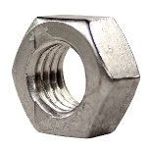
Flow
?

Slide 18

Flow
?

Slide 19

Flow
?

Slide 20
Flow
?

Slide 21
Flow

Slide 22
Flow

Slide 23
Flow

Slide 24
Flow

Slide 25
Flow

Slide 26
Flow
?

Slide 27

Flow
?

Slide 28

Flow
?

Slide 29

Flow
?

Slide 30

Flow
?

Slide 31
Flow
?

Slide 32
Peculiarities
Advantages
Yellow pages based communication
Centralized but robust
Micro contracts
Contract look ahead only 1 step
Little bandwidth overhead
Priority based implementation
Can be changed to target other priorities e.g deadline
Disadvantages
New Type of order will take considerable effort to be included in the system.
Number of transporters define the bottle neck of the system.

Slide 33
Implementation
JADE issues
Minor implementation issues
Tools used
Ticker behaviors
RE Initiators/Responder
Priority Queues
Yellow pages
Finite State Machines

Slide 34
Lessons Learned
Scalable architecture
Can be used ideally in any scenario
Computational complexity restricts to relatively high end devices
ARM based devices ideal
Not suitable for microcontrollers
Deadlines can be accommodated by changing priority number

Slide 35
?

